Slide 1
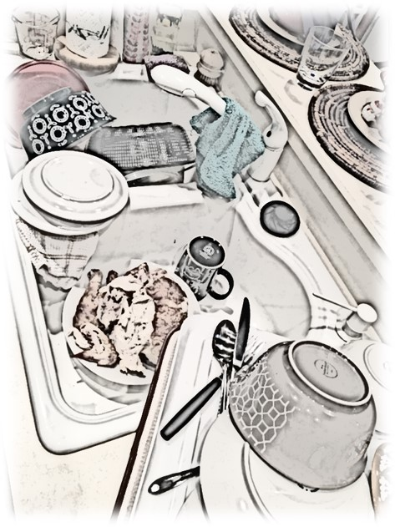
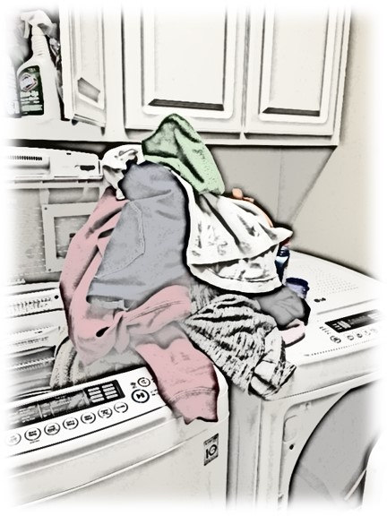
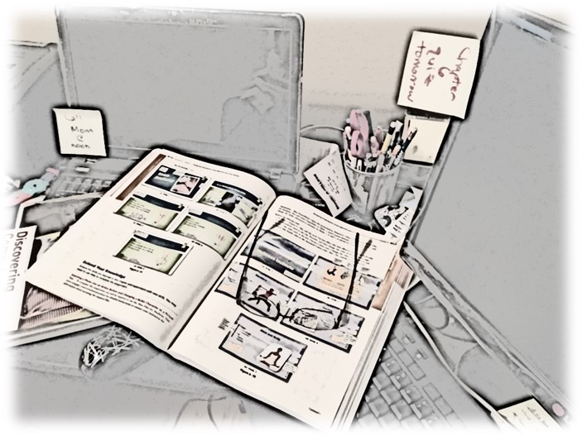
Conquer Your Clutter
Notes:
David Wang, CSE 5 Summer 2020

Slide 2

Clutter Chaos
Affects mental and physical health
Wastes time searching for misplaced items
Causes anxiety and stress
Decreases productivity at work and school

Slide 3
Organize Your Home Office
Put pens, pencils, and scissors in one container
Use in and out baskets to separate mail and important documents
Hang a bulletin board
Develop a filing system

Slide 4
Organize Your Kitchen
Discard crusty sponges
Check expiration dates
Wipe countertops daily
Place utensils in one drawer
Hang shopping list near refrigerator
Install cast-iron rack for pans
Use drawer dividers

Slide 5
Donation Resources
Freecycle
The Global Literacy Project, Inc.
National Cristina Foundation
World Computer Exchange

